Slide 1

CONCEPTIAL DESIGN PRESENTATION

Slide 2

Hasan ÖZKARA -CEO-

Slide 3
Outline of the Presentation
Company Description
Introduction
Overall System Components
Video and Command Transmission
Motor Drive and Shooting Systems
Conclusion

Slide 4
Company Description

Slide 5
Members of the Company
TROY TECH
CEO
Hasan ÖZKARA
COO
Mert KAYIŞ
CFO
Kağan ÖZASLAN
CMO
Mustafa Ercan OKATAN
CTO
Caner POTUR

Slide 6
Mission & Vision
Mission: Our mission is to design and produce creative and reliable electronic Technologies and robotics meeting the desired specifications of customers under limited budget and time.
Vision: Our vision is to be a unique company consisting of highly motivated R&D engineers that create impressive robotic products with affordable and reasonable costs.

Slide 7
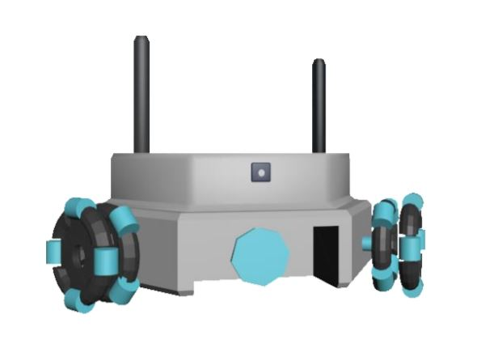
Product – Helen V

Slide 8
Introduction

Slide 9
Problem Statements
Controlling the ball
Shooting the ball to opponent’s goal
Defending the ball coming from opponent

Slide 10
Restrictions & Constraints
Teleoperation from at least 30 meters
Remote control
No crossing to the center-line
No touching to the opponent
Ball transfer to opponent’s field in 20 seconds
Only hitting or pushing the ball
Robot fitting into cylinder of diameter 65cm
Maximum budget of $200

Slide 11
Objectives
Objectives with regard to performance
Objectives with regard to marketing

Slide 12
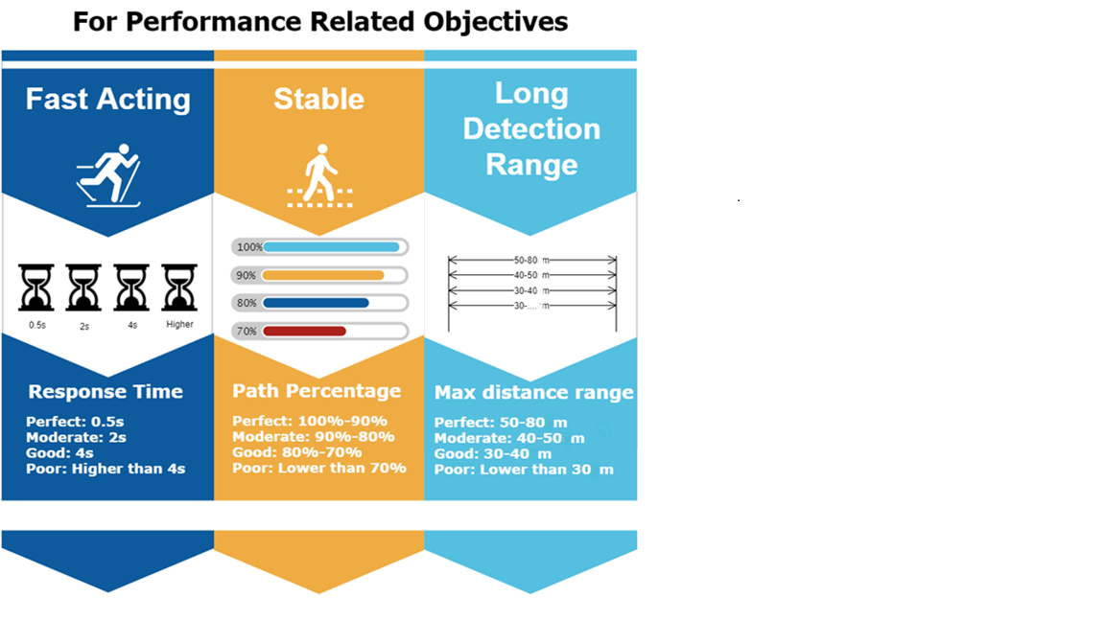

Slide 13
